Slide 1
Training Neural Networks: Gradient Descent, Types of Optimization Techniques and Faster Optimizers

Slide 2
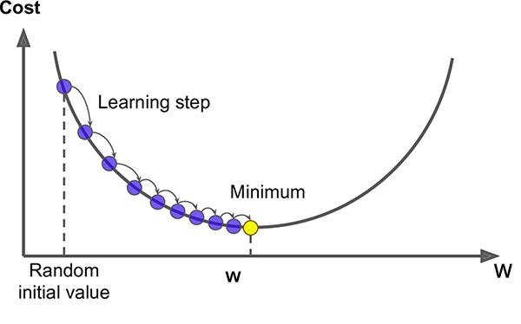
Gradient Descent
Gradient descent is an optimization algorithm used to minimize some function by iteratively moving in the direction of steepest descent as defined by the negative of the gradient.

Slide 3
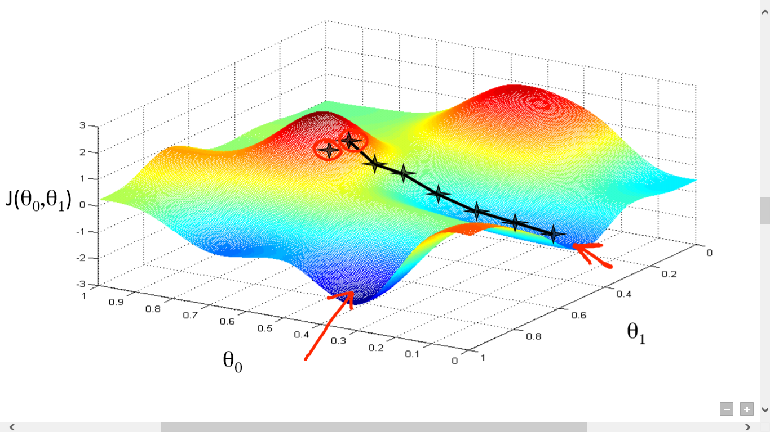

Slide 4
Inputs
X1
Y’ = b0+ b1X1
Y ’ Y’ ’ Y’
Output
Input
Y’

Slide 5
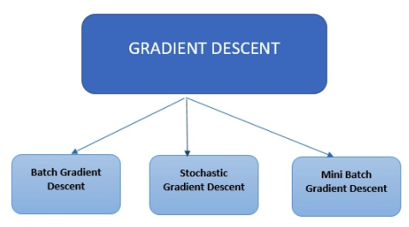
Types of Gradient Descent
Batch Gradient Descent: All training samples per iteration
Stochastic Gradient Descent: Only one training sample per iteration
Mini Batch Gradient Descent: A small number (Batch size) of training samples per iteration

Slide 8
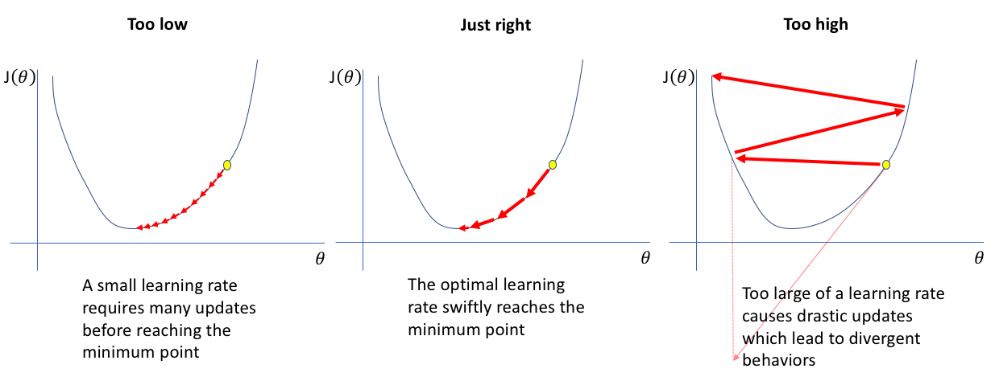
Effect of Learning rate

Slide 9
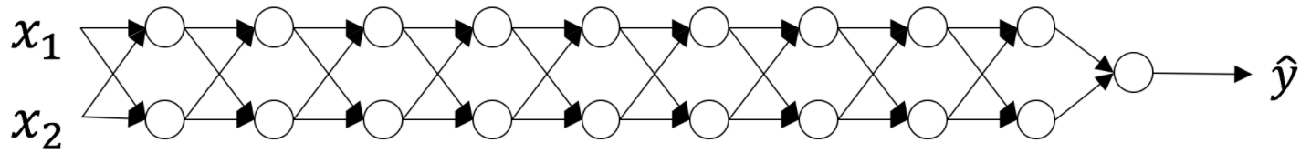
Effect of Parameter Initialization
The initialization step can be critical to the model’s ultimate performance, and it requires the right method. The aim of weight initialization is to prevent layer activation outputs from exploding or vanishing during the course of a forward pass through a deep neural network. If either occurs, loss gradients will either be too large or too small to flow backwards beneficially, and the network will take longer to converge, if it is even able to do so at all.
The problem of exploding or vanishing gradients:

Slide 10
At every iteration of the optimization loop (forward, cost, backward, update), we observe that backpropagated gradients are either amplified or minimized as you move from the output layer towards the input layer.
Case 1: A too-large initialization leads to exploding gradients
Case 2: A too-small initialization leads to vanishing gradients
How to find appropriate initialization values
To prevent the gradients of the network’s activations from vanishing or exploding, we will stick to the following rules of thumb:
The mean of the activations should be zero.
The variance of the activations should stay the same across every layer.

Slide 11
Under these two assumptions, the backpropagated gradient signal should not be multiplied by values too small or too large in any layer. It should travel to the input layer without exploding or vanishing.
Xavier Initialization

Slide 12
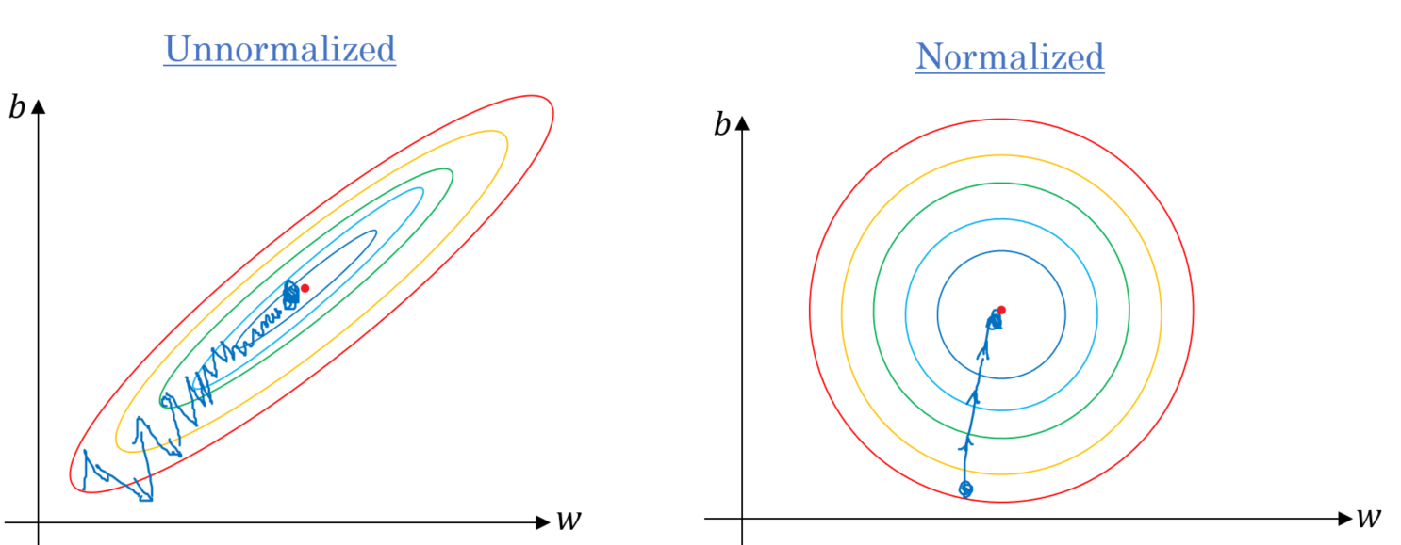
Effect of Normalization

Slide 13
Batch Normalization
Training deep neural networks with tens of layers is challenging as they can be sensitive to the initial random weights and configuration of the learning algorithm.
One possible reason for this difficulty is the distribution of the inputs to layers deep in the network may change after each mini-batch when the weights are updated. This can cause the learning algorithm to forever chase a moving target. This change in the distribution of inputs to layers in the network is referred to the technical name “internal covariate shift.”
Batch normalization is a technique for training very deep neural networks that standardizes the inputs to a layer for each mini-batch. This has the effect of stabilizing the learning process and dramatically reducing the number of training epochs required to train deep networks.

Slide 14
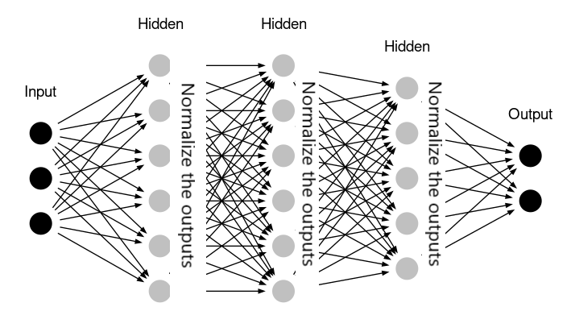
Batch Normalization

Slide 15
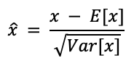
Internal Covariate Shift:
The key issue that batch normalisation tackles is internal covariate shift. Internal covariate shift occurs due to the very nature of neural networks. At every epoch of training, weights are updated and different data is being processed, which means that the inputs to a neuron is slightly different every time. As these changes get passed on to the next neuron, it creates a situation where the input distribution of every neuron is different at every epoch.
How does Batch Normalisation work?
Batch normalisation normalizes a layer input by subtracting the mini-batch mean and dividing it by the mini-batch standard deviation. Mini-batch refers to one batch of data supplied for any given epoch, a subset of the whole training data.

Slide 16
Optimization Techniques
Optimizers are algorithms or special techniques that are used to speed up the
optimization (learning) of neural networks.
Mini Batch Stochastic gradient descent
Mini Batch SGD with Momentum
RMSprop
ADAM optimizer

Slide 18
Mini Batch Stochastic gradient descent
MB-SGD algorithm is an extension of the SGD algorithm and it overcomes the problem of large time complexity in the case of the SGD algorithm. MB-SGD algorithm takes a batch of points or subset of points from the dataset to compute derivative and parameters are updated after every batch.
Stochastic gradient descent usually converges faster than gradient descent on large datasets, because updates are more frequent. Plus, the stochastic approximation of the gradient is usually precise without using the whole dataset because the data is often redundant.
W = W − αdW

Slide 19
Mini Batch SGD with Momentum
A major disadvantage of the MB-SGD algorithm is that updates of weight are very noisy. SGD with momentum overcomes this disadvantage by denoising the gradients. Updates of weight are dependent on noisy derivative and if we somehow denoise the derivatives then converging time will decrease.
The idea is to denoise derivative using exponential weighting average that is to give more weightage to recent updates compared to the previous update.
It accelerates the convergence towards the relevant direction and reduces the fluctuation to the irrelevant direction.
V_{dW}​​=βV_{dW}​+(1−β)dW​​ W = W− α V_{dW}

Slide 20
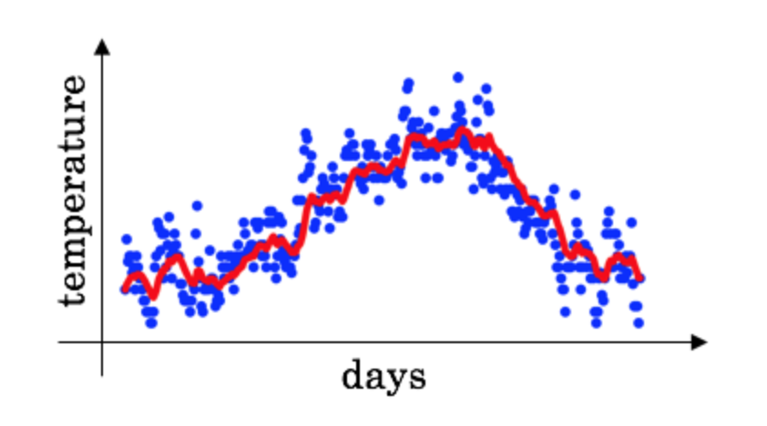

Slide 23
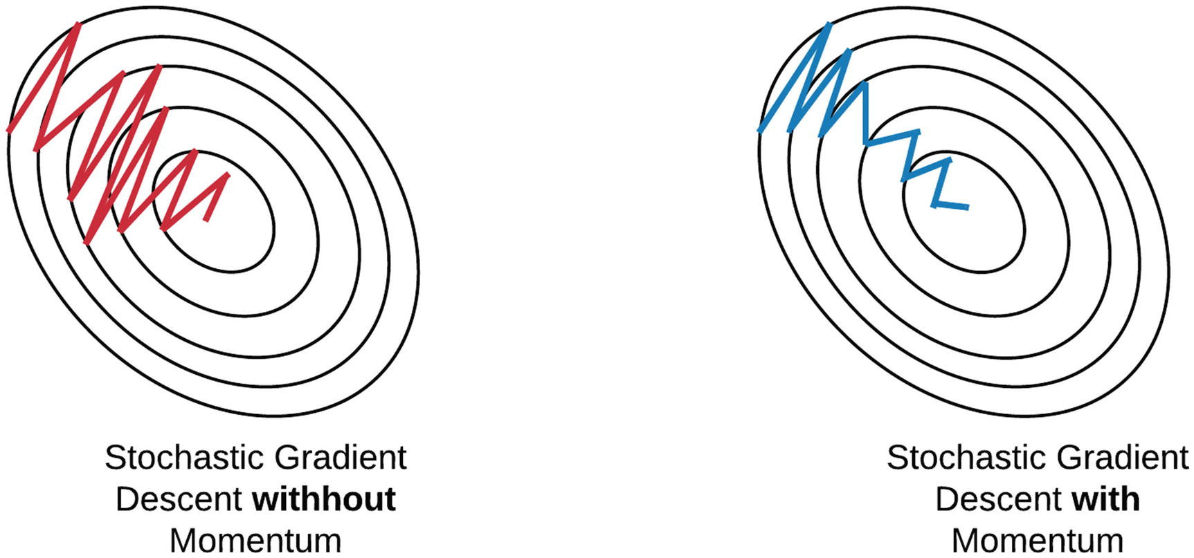
Essentially, when using momentum, we push a ball down a hill. The ball accumulates momentum as it rolls downhill, becoming faster and faster on the way (until it reaches its terminal velocity if there is air resistance, i.e. γ<1). The same thing happens to our parameter updates: The momentum term increases for dimensions whose gradients point in the same directions and reduces updates for dimensions whose gradients change directions. As a result, we gain faster convergence and reduced oscillation.

Slide 25
Nesterov Accelerated Gradient
The idea of the NAG algorithm is very similar to SGD with momentum with a slight variant. In the case of SGD with a momentum algorithm, the momentum and gradient are computed on the previous updated weight.
Momentum may be a good method but if the momentum is too high the algorithm may miss the local minima and may continue to rise up. So, to resolve this issue the NAG algorithm was developed. It is a look ahead method
While Momentum first computes the current gradient (small brown vector in Image 4) and then takes a big jump in the direction of the updated accumulated gradient (big brown vector), NAG first makes a big jump in the direction of the previously accumulated gradient (green vector), measures the gradient and then makes a correction (red vector), which results in the complete NAG update (red vector). This anticipatory update prevents us from going too fast and results in increased responsiveness, which has significantly increased the performance of RNNs on a number of tasks.

Slide 26
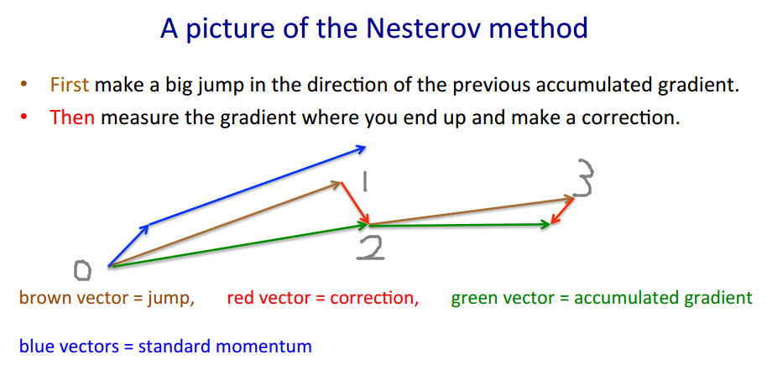
Both NAG and SGD with momentum algorithms work equally well and share the same advantages and disadvantages.

Slide 27
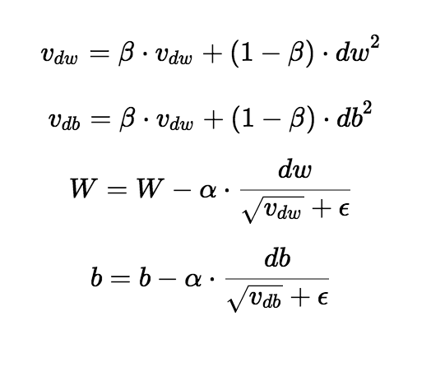
RMSprop
The central idea of RMSprop is keep the moving average of the squared gradients for each weight. And then we divide the gradient by square root the mean square. Which is why it’s called RMSprop(root mean square) .
RMSprop’s adaptive learning rate usually prevents the learning rate decay from diminishing too slowly or too fast. RMSprop maintains per-parameter learning rates.
​​

Slide 29
ADAM Optimizer
Adam can be looked at as a combination of RMSprop and Stochastic Gradient Descent with momentum.
Adam computes adaptive learning rates for each parameter. In addition to storing an exponentially decaying average of past squared gradients vt like Adadelta and RMSprop, Adam also keeps an exponentially decaying average of past gradients mt, similar to momentum. Whereas momentum can be seen as a ball running down a slope, Adam behaves like a heavy ball with friction, which thus prefers flat minima in the error surface.
The hyperparameters of Adam (learning rate, exponential decay rates for the moment estimates, etc.) are usually set to predefined values (given in the paper), and do not need to be tuned.
Adam performs a form of learning rate annealing with adaptive step-sizes.

Slide 30
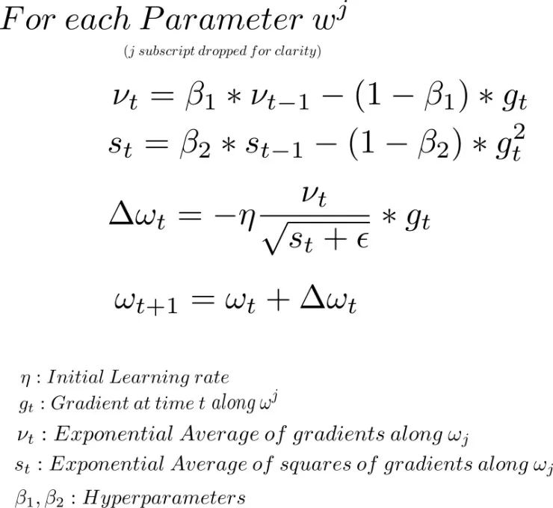

Slide 33
